Slide 1

Image Processing and Computer Vision Laboratory
CSE 4128
Project Title: Cartooning an Image
Supervised By:
Dr. Sk. Md. Masudul Ahsan
Professor
Department of CSE, KUET
Dipannita Biswas
Lecturer
Department of CSE, KUET
Submitted By:
Proloy Karmakar
Roll: 1907051
Year: 4th
Term: 1st
Date of Submission: 30-06-2024

Slide 2
Objectives
Understand Image Processing Techniques: Learn about various image processing techniques and their applications, focusing on the methods used for cartooning an image.
Implement Cartooning Algorithm: Develop and implement an algorithm to convert a photograph into a cartoon-like image using filters and edge detection methods.
Create a User-Friendly Interface: Design a user-friendly interface that allows users to upload images and apply the cartooning effect easily.
Analyze Results: Analyze the results of the cartooning process and discuss the strengths and limitations of the implemented methods.

Slide 3
Introduction
Cartooning an image is a fascinating area of image processing that transforms
real-world photographs into cartoon-like representations. This process involves
several steps, including edge detection, image segmentation, and color
quantization, to simplify the image while maintaining its essential features.
Cartoon images are characterized by bold edges and smooth, flat areas of color,
which give them a distinctive, stylized appearance.
Overall, this project combines theoretical knowledge with
practical application, providing a comprehensive understanding
of the cartooning process and its potential uses in various fields
such as digital art, entertainment, and media production.

Slide 4
Theory
I used different methods to make a cartoon of an image. These are as
follows:
1. Pencil Sketching of an Image:
Pencil sketching an image is a popular technique in image processing that
transforms a photograph into a grayscale image resembling a hand-drawn pencil
sketch. This process involves several steps that mimic the texture and
appearance of pencil strokes. The key steps in the pencil sketching
process are as follows:

Slide 5
Theory
Read Image
Convert it to Grayscale
Medial Filter
Edge Detection
Apply Thresholding
Apply Negative
Pencil Sketched image
Fig 1: Procedure of Pencil Sketching

Slide 6
Theory
2. Color Quantization of an Image:
Color quantization is the process of reducing the number of distinct colors in an
image. This is particularly useful for compressing images and for achieving
certain artistic effects, such as creating cartoon-like images. The goal is to retain
as much visual information as possible while using a limited palette of colors.
Here are the key concepts and steps involved in color quantization:

Slide 7
Theory
Read Image
Operate over color space
Clustering of distinct colors
Set all the pixels to the mean color of the cluster
Color Quantized Image
Fig 2: Procedure of Color Quantizing

Slide 8
Theory
3. Comic Book Style Cartoon Image:
Creating a comic book-style cartoon image involves transforming a
photograph into an image that resembles the unique, stylized artwork
found in comic books. This process combines various image-processing
techniques to achieve the distinctive look of comic art, which typically
features bold outlines, flat colors, halftone shading, and sometimes
exaggerated features.

Slide 9
Theory
Read Image
Convert it to a GrayScale image
Apply Adaptive Thresholding
Comic Book Style Image
Fig 3: Procedure of Comic Book Style Cartoon Image

Slide 10
Theory
4. Outline and Edge Detection Cartoon Image:
Creating a cartoon effect on an image using an outline and edge detection
involves a combination of techniques to simplify the image's color palette and
emphasize its edges. This process highlights the boundaries of objects and
reduces the complexity of the colors, giving the image a
stylized, cartoon-like appearance.

Slide 11
Theory
Read Image
Convert it to Grayscale
Median Filter
Edge Detection
Apply Thresholding
Apply Negative
Bilateral Filter
Make the same dimensions as the negative image
Bitwise And
Cartoon Image
Fig 4: Procedure of Outline and Edge Detection Cartoon Image

Slide 12
Complete Work-Flow
Choose the type of image cartooning
Upload Image
Get the Cartoon Image
Fig 5: Complete Workflow Diagram of this project

Slide 13
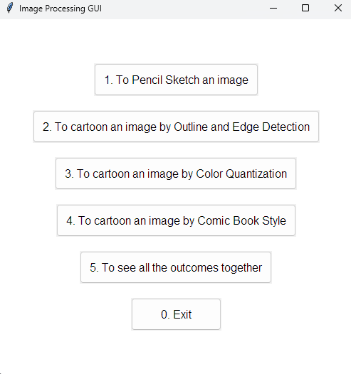
Sample Input and Output
Fig 6: Graphical User Interface to Choose Type of Cartooning

Slide 14
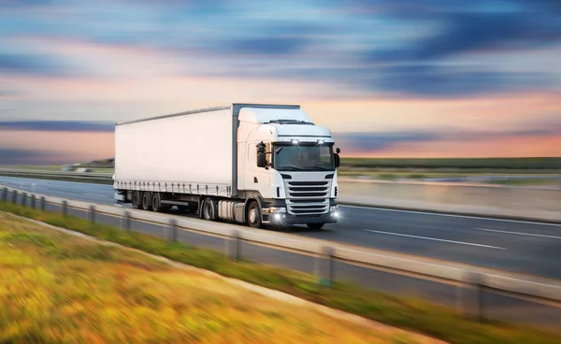
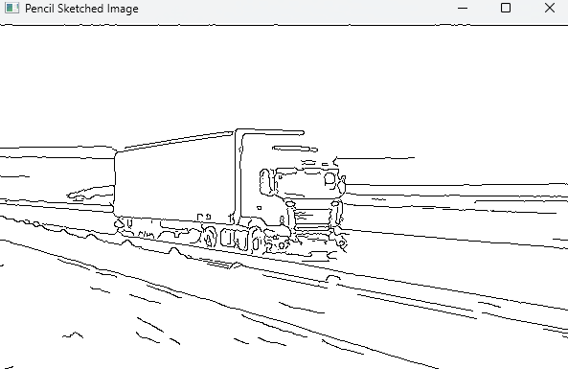
Sample Input and Output (Pencil Sketch)
Input
Output
Fig 7: Input and Output of Pencil Sketching Method

Slide 15
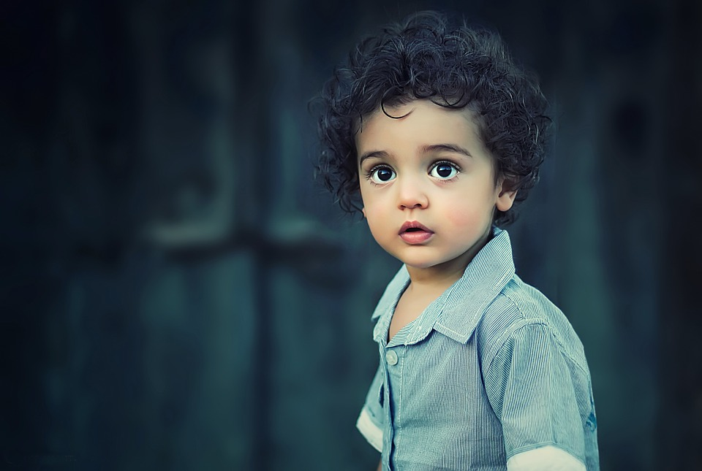
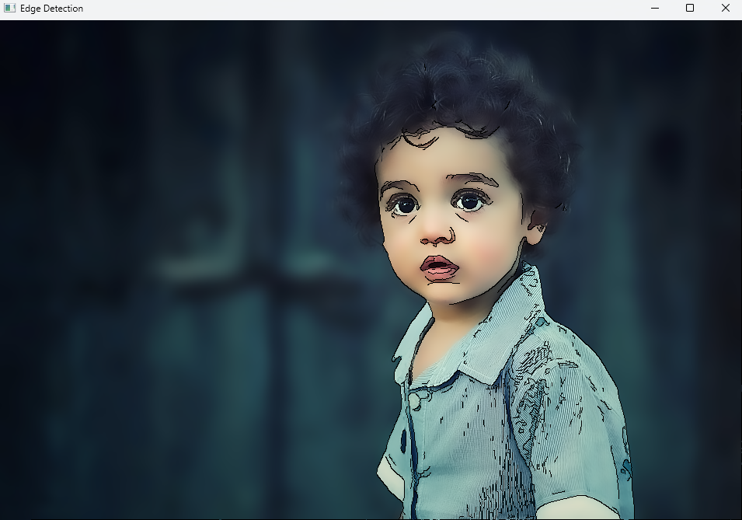
Sample Input and Output (Outline and Edge Detection)
Input
Output
Fig 8: Input and Output of Outline and Edge Detection Method

Slide 16
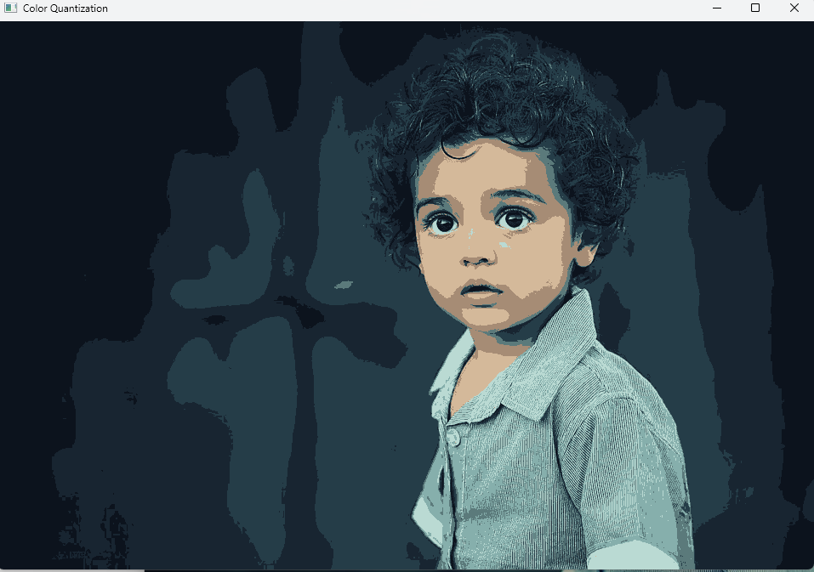
Sample Input and Output (Color Quantization)
Input
Output
Fig 9: Input and Output of Color Quantization Method

Slide 17
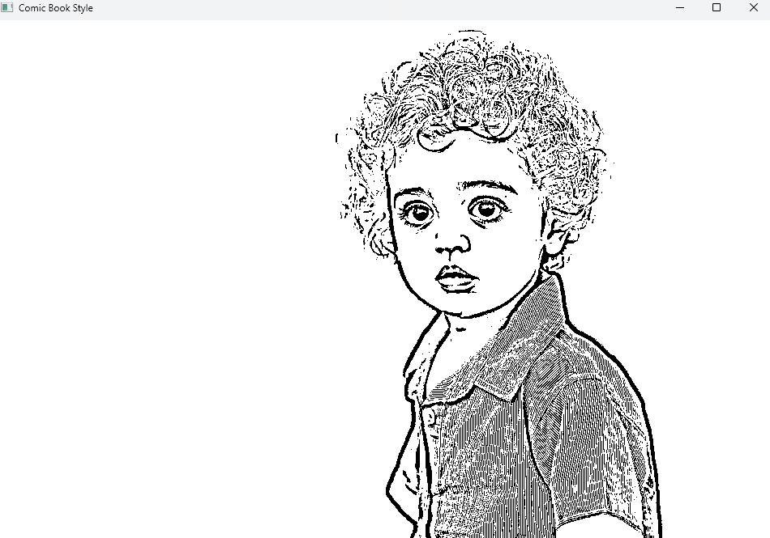
Sample Input and Output (Comic Book Style)
Input
Output
Fig 9: Input and Output of Comic Book Style Method

Slide 18
Discussion
The project of cartooning an image can be performed using different methods.
In this project, I used 4 types of methods. using an outline and edge detection
provides a practical application of several fundamental image processing
techniques. By smoothing the image, detecting edges, and quantizing colors, we
can transform a photograph into a stylized, cartoon-like image. Each step in the
process contributes to the final effect, and understanding these steps
offers insights into the broader field of digital image manipulation.
Comic Book Style works by using adaptive thresholding. Color Quantization
methods find the number of distinct colors and reduce it by setting all the pixels
with the same color as the mean color of the corresponding cluster.

Slide 19
Conclusion
The project successfully demonstrates the process of converting a
photograph into a cartoon-like image using outline and edge detection. By
implementing a series of well-established image processing techniques,
we achieved a stylized effect that highlights the edges and simplifies the
color information in the image.

Slide 20
Application
This project has applications in various fields, including
digital art
graphic design
media production.
The cartooning effect can be used to create artistic images, enhance
Visual storytelling, and developing unique visual content for marketing and
entertainment.

